Slide 1

Business Intelligence course
MENDELEY
SMART SUPPLY CHAIN
By Group ?
01

Slide 2
Presentation Agenda
Key topics for discussion
01
Introduction to Company
02
Description of Source Data
03
Data Discovery Process
04
Identification of Business Needs
05
Dimensional Model

Slide 3
Product shipment company in a timely and cost-efficient manner
Introduction to
Mendeley
Company has an average order value of $183 from which it profits of $22. s
Most products shipped are sports related, however other categories like clothing and electronic supplies are also dispatched.
03

Slide 4
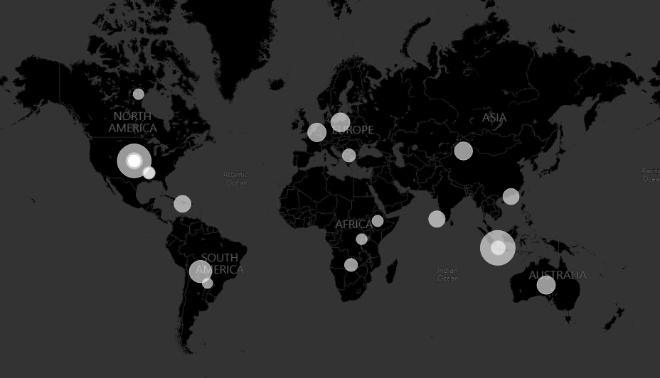
Introduction to
Mendeley
The company owns several warehouses in Puerto Rico (PR) and the United States of America (US)
Total of 7458 warehouses in 563 different cities through the US and PR .Mendeley sends its products to 164 countries in more than 3500 different cities.
Company ships products
to different markets
Latin America (LATAM)
Europe
Pacific Asia
United States
Canada (USCA)
Africa
03

Slide 5
Bounce rate
Search engine optimization
65.5%
1 in 5
users who visit and leave without visiting a different link on the page
pages that reach the minimum level of optimization
Presentations are communication tools that can be used as demonstrations, lectures, speeches, reports, and more. It is mostly presented before an audience.
Presentations are communication tools that can be used as demonstrations, lectures, speeches, reports, and more. It is mostly presented before an audience.
05

Slide 6

Summary of Content
Strategy Audit
A combination of strengths and opportunities
04

Slide 7
01
02
Maintain and update editorial calendar
Follow new brand style guide
Presentations are communication tools that can be used as demonstrations, lectures, speeches, reports, and more.
Presentations are communication tools that can be used as demonstrations, lectures, speeches, reports, and more.
New Content Guidelines to Observe
03
04
Always include researched keywords
Follow SEO guide
Presentations are communication tools that can be used as demonstrations, lectures, speeches, reports, and more.
Presentations are communication tools that can be used as demonstrations, lectures, speeches, reports, and more.
05
06
Always use brand hashtags
Include internal links when applicable
Presentations are communication tools that can be used as demonstrations, lectures, speeches, reports, and more.
Presentations are communication tools that can be used as demonstrations, lectures, speeches, reports, and more.
10

Slide 8



Content Strategy Audit Highlights
The homepage is updated and optimized, but other landing pages need improvement
Blog presents opportunities to publish new content or re-purpose old content
Overall search engine optimization needs improvement
Presentations are communication tools that can be used as demonstrations, lectures, speeches, reports, and more. It is mostly presented before an audience.
Presentations are communication tools that can be used as demonstrations, lectures, speeches, reports, and more. It is mostly presented before an audience.
Presentations are communication tools that can be used as demonstrations, lectures, speeches, reports, and more. It is mostly presented before an audience.
03

Slide 9


New Content Channels to Publish
01
02
03
Product People Forum
WhutzHappz
SnapzSpace
Presentations are communication tools that can be used as demonstrations, lectures, speeches, reports, and more.
Presentations are communication tools that can be used as demonstrations, lectures, speeches, reports, and more.
Presentations are communication tools that can be used as demonstrations, lectures, speeches, reports, and more.
06

Slide 10
Thank you for your time!
Please feel free to ask your questions
10

